Slide 1
Electronic measurements and sensors
DIGITAL PIANO
UNIVERSITATEA TEHNICĂ CLUJ NAPOCA

Slide 2

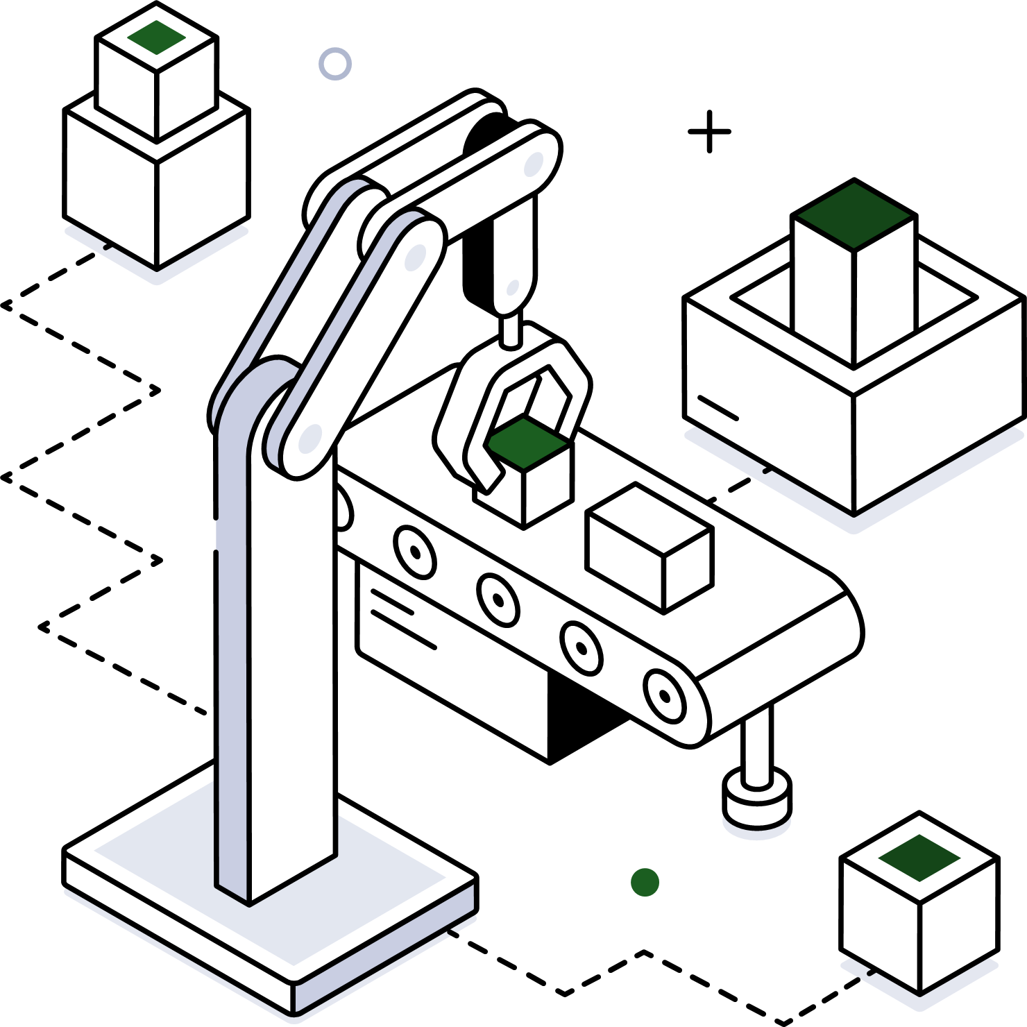
Summary of the project
What we use, how it works, why it works…
1. Components list
2. Functionality
Short presentation of every used sensor and actuator.
Explanation of functionality and utility.
3. Workflow
4. Final opinions
Display of images depicting the workflow steps and chunks of code.
Final takes and opinions, options to improve, and conclusions.

Slide 3
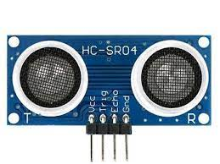
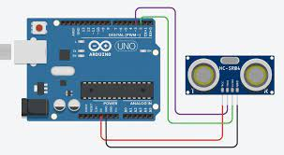
1. Components list
Short presentation of every used sensor and actuator.
1.1. Distance sensor HC-SR04
The HC-SR04 is an affordable and easy to use distance measuring sensor which has a range from 2cm to 400cm (about an inch to 13 feet).
The sensor is composed of two ultrasonic transducers. One is transmitter which outputs ultrasonic sound pulses and the other is receiver which listens for reflected waves. It’s basically a SONAR which is used in submarines for detecting underwater objects.

Slide 4
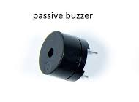
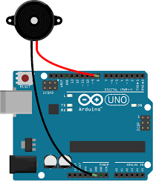
1. Components list
Short presentation of every used sensor and actuator.
1.2. Passive Buzzer
One advantage of passive buzzers over active buzzers is that you can control the tone or pitch of the sound produced by the buzzer. With active buzzers only one tone is possible, but with passive buzzers any tone within the dynamic range of the buzzer is possible.
Passive buzzers need a square wave signal to produce sound. By changing the frequency of the square wave you can change the pitch of the sound.

Slide 5
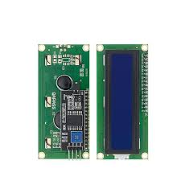
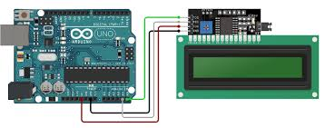
1. Components list
Short presentation of every used sensor and actuator.
1.3. PCF8574A LCD – I2C Converter
The PCF8574A LCD with I2C converter is a versatile module designed to simplify the integration of an LCD display with microcontrollers through the I2C communication protocol. It acts as a bridge between the microcontroller and the LCD, minimizing wiring complexity and coding effort. This module is commonly used in projects requiring user-friendly visual displays, such as information panels, temperature monitors, and digital clocks. It allows developers to easily control and display text or graphics on the LCD, enhancing the overall usability and aesthetics of their electronic devices and applications.

Slide 6
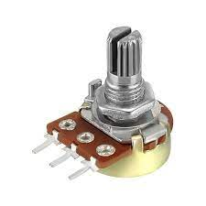
1. Components list
Short presentation of every used sensor and actuator.
1.4. Potentiometer
The 50kOhm potentiometer serves as a precise control component, enabling the adjustment of backlight intensity for LCD displays. Its variable resistance allows users to fine-tune the brightness, providing optimal visibility in different lighting conditions. This potentiometer acts as an intuitive on/off switch for the LCD backlight, enhancing user experience and ensuring efficient power management, making it a valuable addition to various electronic devices requiring display illumination control.

Slide 7
2.1. Functionality
1. Tracking distance
2. Sound effects
The distance sensor is used to measure a value lower than 74 and outputs different values for different ranges ( ex. range of 10-18 ).
The value passed by the distance sensor is used as a parameter, which will determine a frequency specific to a musical note which will be outputted by the buzzer.
3. Note LCD display
4. Backlight adjustment using potentiometer
Next, the LCD displays the played note, again based on the distance sensors output, to be sure that we are outputting the needed note.
At last, we adjust the backlight ON/ OFF using the potentiometer.

Slide 8
2.2. Utility
1. Musicality
2. Room for expansion
The presented project can easily get by as a functional digital piano, which can be played by a persons that has some musical theory knowledge.
Diverging from the conventional piano setup, our piano can be expanded to have many notes as the distance can be measured further than the length of a classical piano.
3. Notes display
Also different from a classical piano, the digital piano displays the sung notes, therefore a disabled person ( in the terms of deafness) can see what is being played, an excellent feature if we were to ask one of the greatest composers of all time, Ludwig van Beethoven.

Slide 9
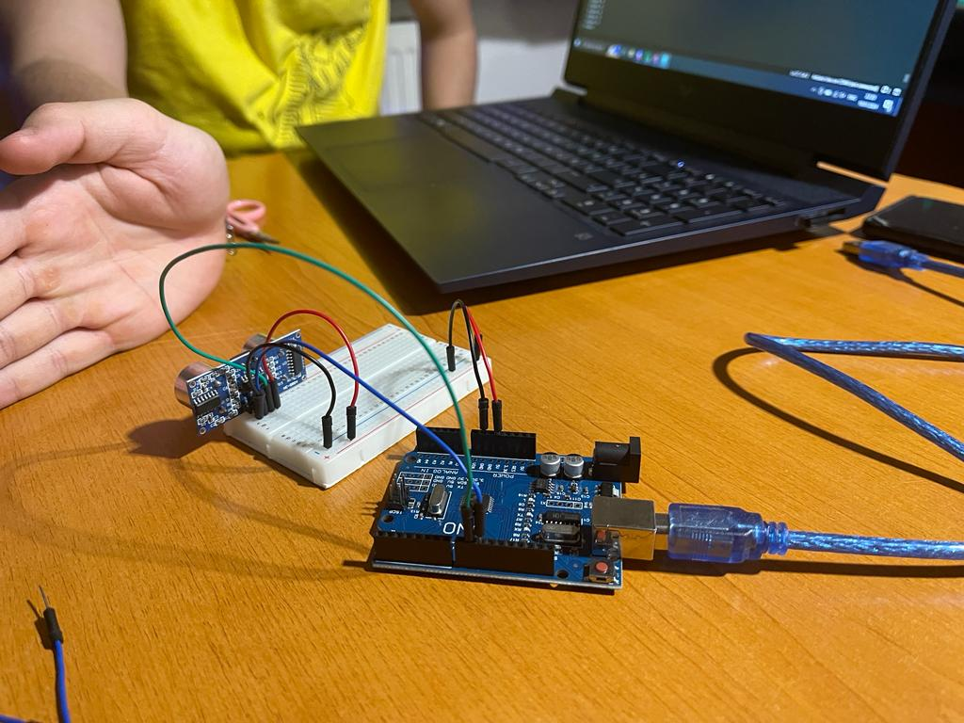
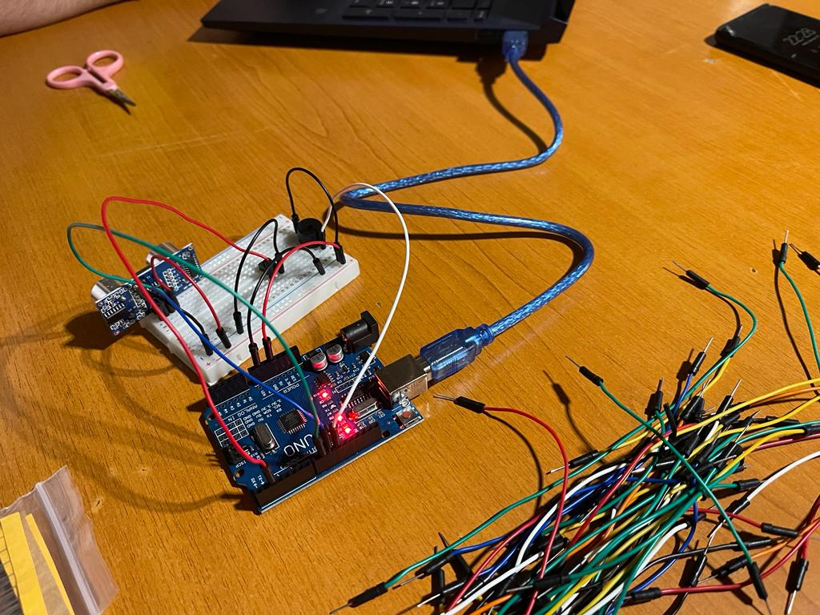
3. Workflow
Short presentation of every taken step.
3.1. Implementing the Distance sensor
3.2. Implementing the Buzzer

Slide 10
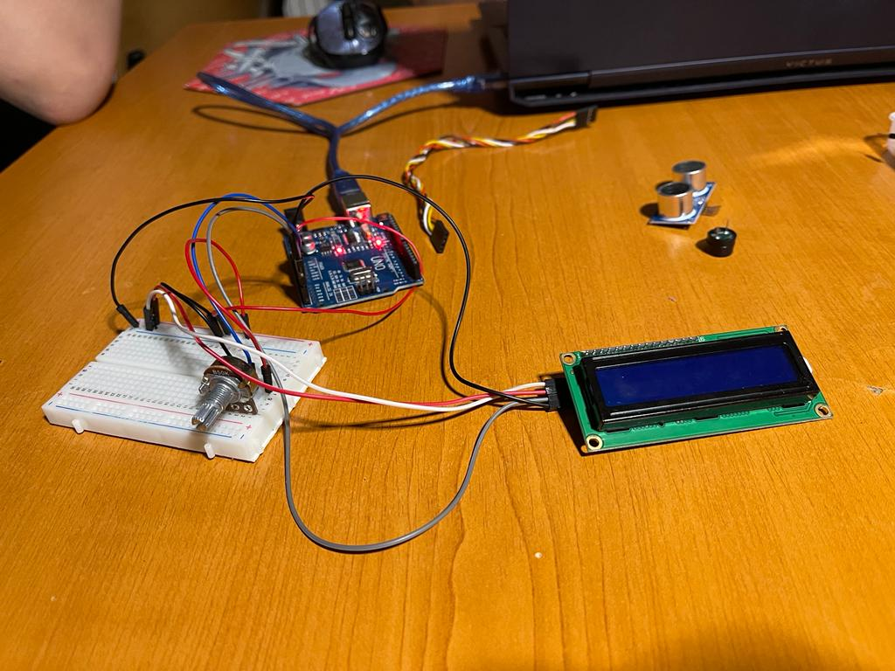
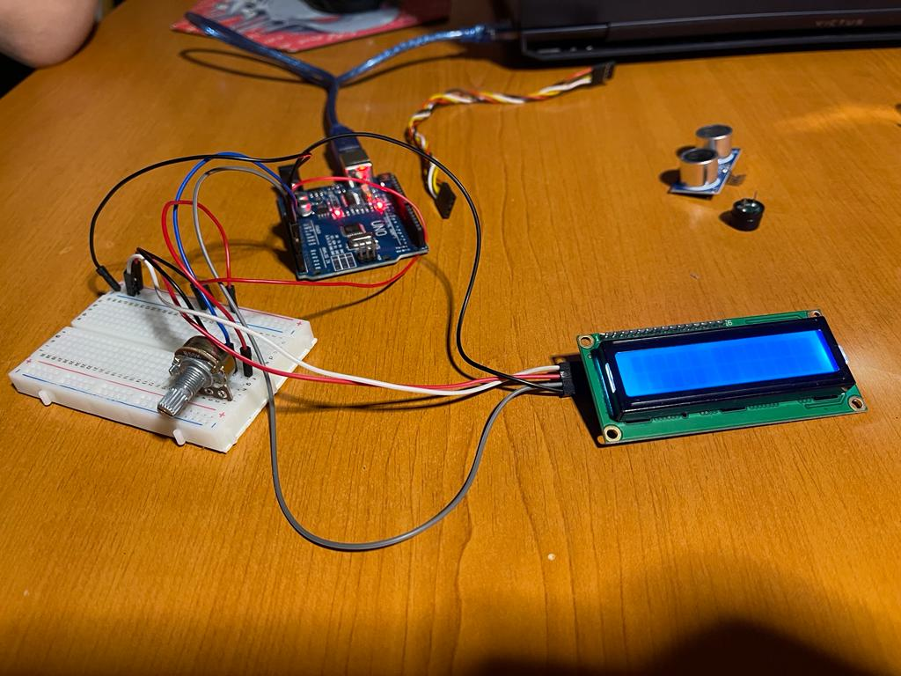
3. Workflow
Short presentation of every taken step.
3.3. Adding the LCD
3.4. Implementing the Potentiometer

Slide 11
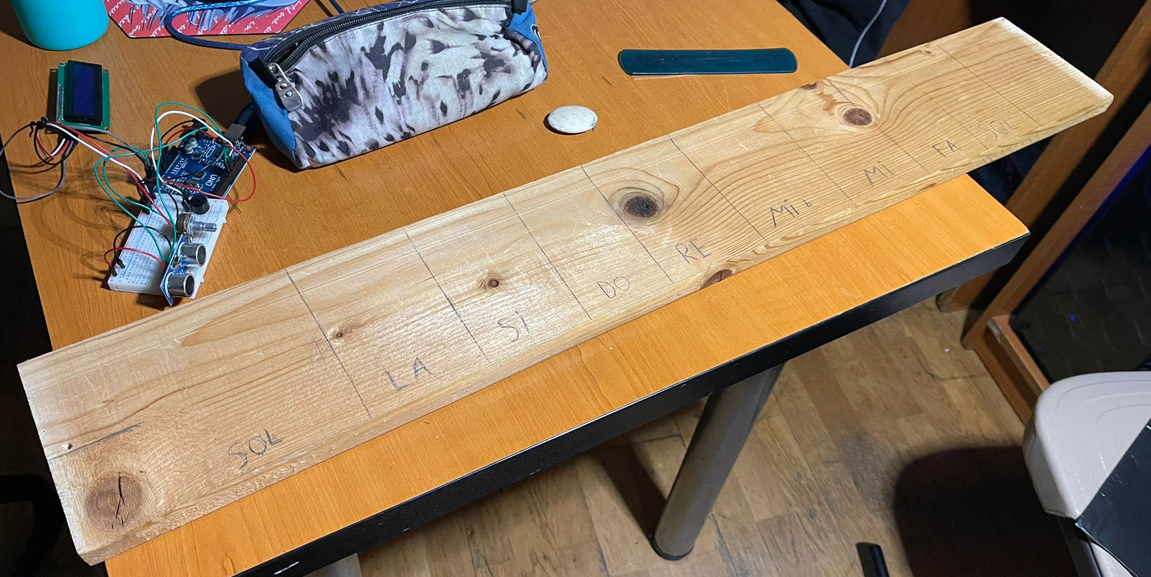
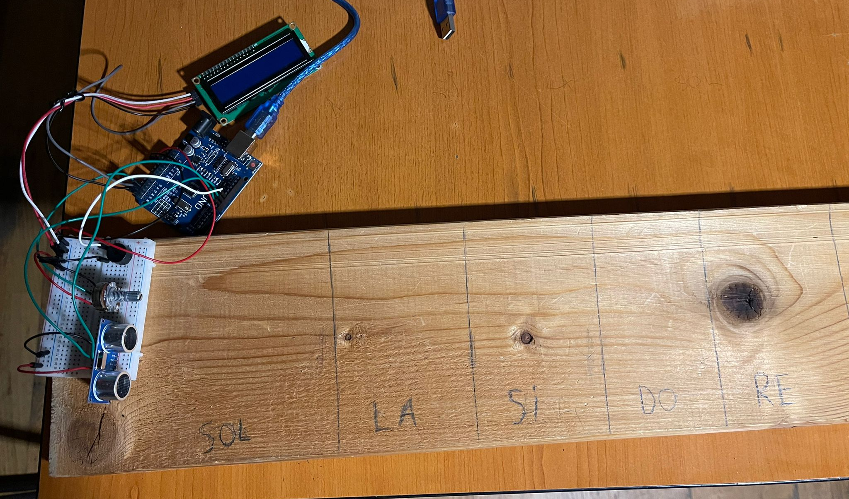
3. Workflow
Short presentation of every taken step.
3.5. Adding the measuring board
3.6. Final product

Slide 12
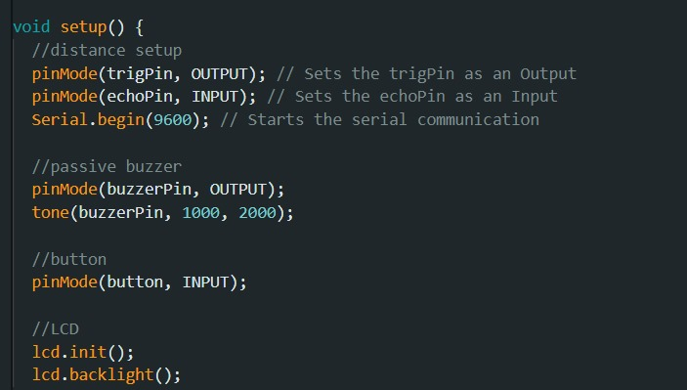
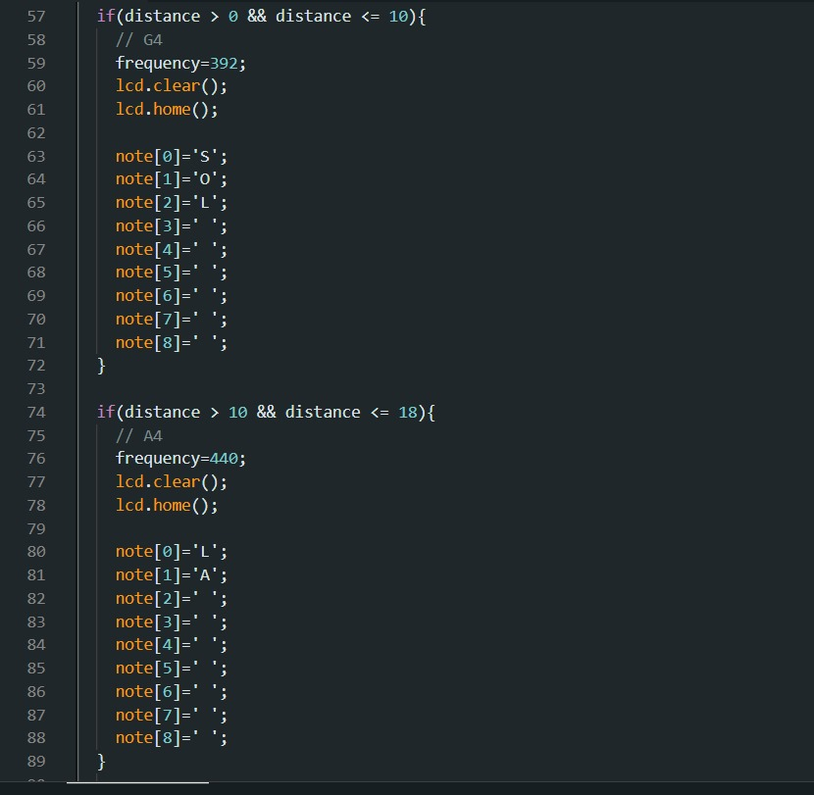
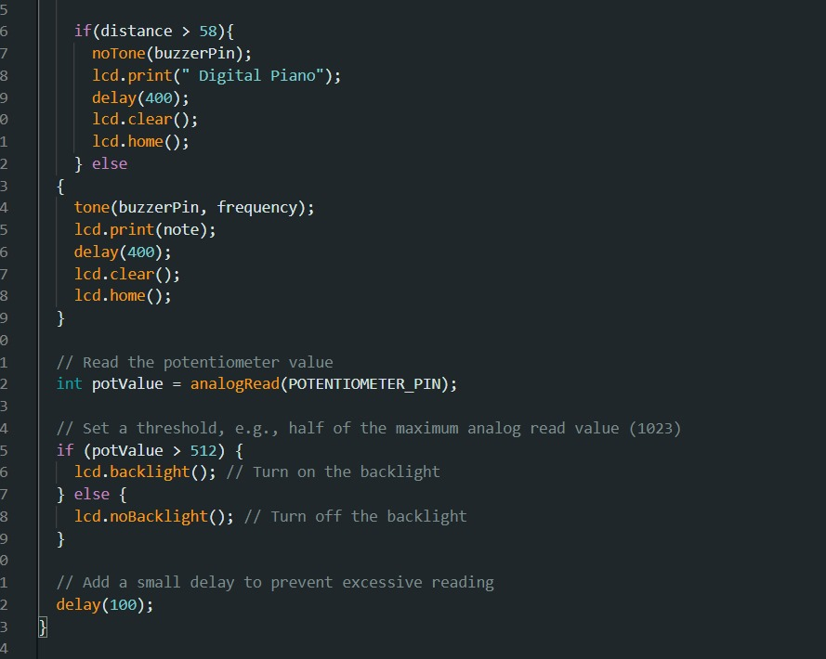
3.7. Chunks of code

Slide 13
4. Final opinions
4.1. Impressions
This project represented a unique opportunity to learn more about sensors and actuators, all while mastering using an Arduino board. We had to make a lot of research, but in the end the teamwork made the dream work and we ended up with an interesting digital piano.
4.2. Further updates
As for further updates, we could vary the notes, maybe make some switches to change octaves, or display different things on the LCD.

Slide 14
Thank you!
Participants:
CTI Group 30425:
Mureșan Andrei Ioan
Crăciunaș Victor
Neghină Vlad Ioan
IS Group 30322:
Vilău Paul Andrei

